Slide 1
RANI SAHIB KAUR
THE WARRIOR PRINCESS

Slide 2
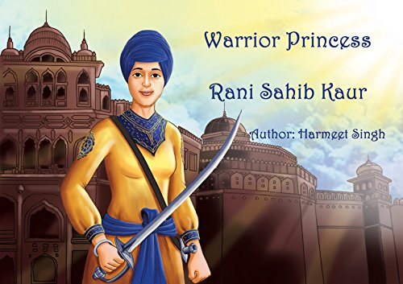
PATIALA GOT THE PRINCESS
Patiala named after its first ruler Ala Singh
In 1771 Rani Raj Kaur and Raja Amar Singh grandson of Ala Singh was blessed with princess
She was named Sahib Kaur
She took Khandey di Pahul at a very young age
She was a devoted Sikh
She learnt horseback riding and got training of all kinds of weapons
She got married to Sardar Jaimal Singh of Kanheiya Misal

Slide 3
SAHIB KAUR BECOMES THE PRIME MINISTER
After the death of Raja Amar Singh, his son Sahib Singh became the King
He was only 7 year old
His Prime Minister Nanu Mal became greedy
Sahib Singh replaced him with his sister Sahib Kaur
Rani Sahib Kaur replaced all corrupt officials with honest ones
She constructed new forts and restored peace & prosperity in the state
News came that her husband is captured by a rival chief Fateh Singh
She lead a large army, attacked the rivals and rescued her husband and restored back his kingdom.

Slide 4
MARATHAS ATTACKED PATIALA
News came that Marathas were marching towards Patiala with a large army carrying advance weapons and cannons
Rani Sahib Kaur called a meeting of kings and chiefs of neighboring states
She convinced them to fight even though they were not well equipped
She was able to gather a combined force of 7000 warriors
She met the Maratha forces in the battlefield of Mardanpur, Ambala
She addressed her chiefs and soldiers: “I have pledged to return victorious. We are fighting for peace and justice. Guru Sahib preserves the honor of his Sikhs”

Slide 5
DETERMINED TO FIGHT AND WIN
First day: Cannon fire caused sever casualties of Sikh forces
Rani Sahib Kaur kept her faith in Guru Sahib
By night fighting was so fierce that the Sikh soldiers wanted to retreat
She roared, “You retreat if you want to, but I am determined to fight till the end of my life”
She lead the attack at midnight as Marathas were enjoying their victory and gave them a surprise
Sikhs burst upon the camp of enemies as the lion attacks the herd
Maratha forces ran for their lives and never looked back towards Punjab

Slide 6
GEORGE THOMAS AND RANI SAHIB KAUR
After 2 years of peace, George Thomas attacked kingdom of Jind
King of Jind asked for help from Patiala
Rani Sahib Kaur left for Jind to help against her brother’s wishes
She attacked Thomas’s stronghold, cut the supply lines
After 100 days of siege, Thomas ran away towards Hansi
Sikh forces followed Thomas but Thomas attacked them at night
Sikh forces had to retreat and seek help from Rani Sahib Kaur
She gathered her forces, attacked him and made him sign peace and surrender agreement
She passed away in 1799
She is remembered as the honest & courageous PM and a dedicated Sikh

