Slide 1
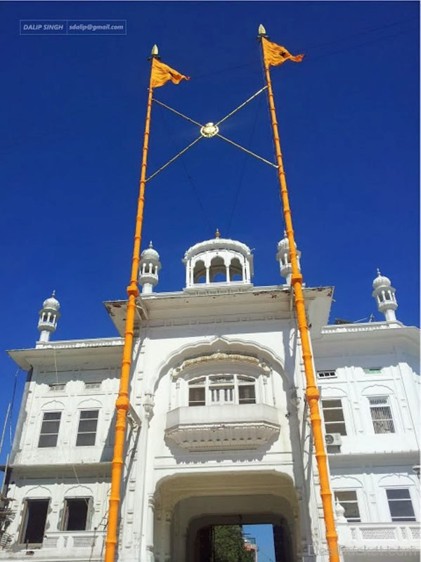
NISHAAN SAHIB
2019 SIKH Gurmat Camp

Slide 2
SIGNIFICANCE
It's significance is simply as much as if not more than that of the flag of a Nation or Country!
Gurdwara – Sikh place of worship & education is recognized from a far distance by the highly and mightily placed Nishan Sahib.
Nishan Sahib reminds every one of the Greatness of One Waheguru, Whose Praises are sung here

Slide 3
SIGNIFICANCE
Every one is welcomed here irrespective of their caste, creed, color, gender, status or religious affiliation
Shelter, food and any other kind of help or assistance is provided to all, if there is provision for such services at this location

Slide 4
UNIQUE FLAG OF SIKH NATION
Never flown at half mast ever !
Inside the Darbar Sahib, Amritsar, there is only one painting of human figures - a painting of Guru Gobind Singh jee with a Nishan Sahib.
ਸਿੱਖਾਂ ਨੂੰ ਸਿੱਖੀ ਦਾਨ, ਕੇਸ ਦਾਨ, ਰਹਿਤ ਦਾਨ, ਬਿਬੇਕ ਦਾਨ, ਵਿਸਾਹ ਦਾਨ, ਭਰੋਸਾ ਦਾਨ, ਦਾਨਾਂ ਸਿਰ ਦਾਨ ਨਾਮ ਦਾਨ, ਸ੍ਰੀ ਅੰਮ੍ਰਿਤਸਰ ਜੀ ਦੇ ਇਸ਼ਨਾਨ, ਚੌਂਕੀਆਂ, ਝੰਡੇ, ਬੁੰਗੇ ਜੁਗੋ ਜੁਗ ਅਟਲ, ਧਰਮ ਕਾ ਜੈਕਾਰ, ਬੋਲੋ ਜੀ ਵਾਹਿਗੁਰੂ ॥

Slide 5
UNIQUE FLAG IN ARDAAS
Confer upon the Sikhs the gift of Sikhi, the gift of (uncut) hair, the gift of observing Sikh principles, the gift of divine knowledge, the gift of firm faith, the gift of belief and the biggest gift of all, the gift of Name (Naam) – May they take a shower in the Sarovar of Naam. O God! May the choirs, the mansion and the banners keep on flying forever; may the truth ever triumph; say Waheguru !

Slide 6
IMPORTANCE OF NISHAN SAHIB
During the second battle of Anandpur Sahib around 1704 CE, Bhai Alam Singh, who was carrying the Sikh Nishan Sahib, was captured by the Mughals.
The Mughal Commander ordered Alam Singh to "throw the Nishan Sahib down ".

Slide 7
Fearless alam singh
Bhai Alam Singh replied, "THIS Flag is the symbol of my personal dignity and that of my Guru and I will never let it fall".
The Mughal Commander said "we will cut off your hands, in that case."
The fearless Bhai Alam Singh without any hesitation replied, "In that case, I will carry the Nishan Sahib with my feet."

Slide 8
Nishan sahib belongs to the guru
The Mughal said, “We will cut off your legs”.
Bhai Alam Singh boldly defying, responded, "Then, I will hold it with my mouth! This flag belongs to my GURU, I will never let it fall ever"
The commander retorted, “we will blow your head off, what will you do then?” Bhai Alam Singh responded by saying "I will hold it high as long as breathe. My Guru will protect it to whom it belongs”.

Slide 9
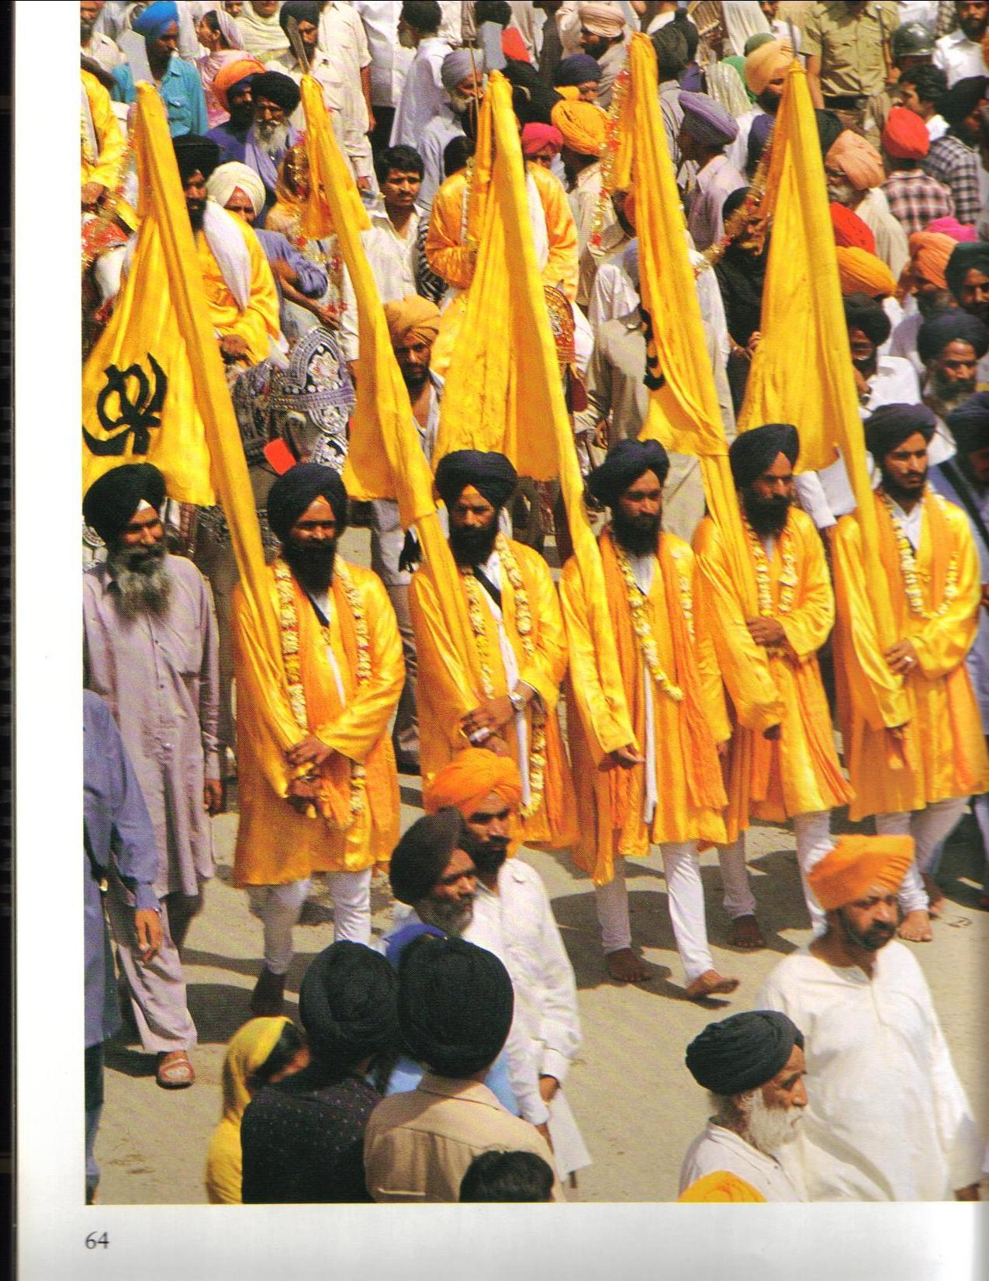

Slide 10
SIKH SLOGANS
ANNOUNCER SANGAT – EVERYBODY
DEG – TEG FATEH
PANTH KEE JEET
RAAJ KAREGA KHALSA
JHOOLTEY NISHAAN RAHEN PANTH MAHARAJ KAY
BOLEY SO NIHAAL SAT SIRI AKAAL
May the Flags of the Panth keep on flying!

