Slide 1
MATA KHEEVI JEE
Honorable mention in Guru Granth Sahib

Slide 2
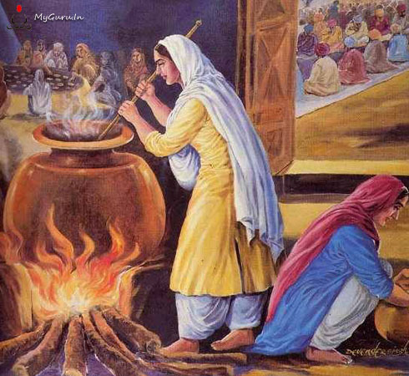
MATA KHIVI JEE IN THE LANGAR

Slide 3
MATA KHIVI PRAISED IN GURU GRANTH SAHIB
Guru Angad Dev jee was addressed as the Husband of Mata Khivi
It was written by Bhai Balwand, who wrote one full Paurhi in praise:
As Guru Angad Dev jee is distributing the Langar of Shabad to the Sangat, his wife Mata Khivi is serving sweet delicious rice pudding in Guru ka Langar.
Balwand says: Mata Khivi is a noble lady. She is like a tree with a large number of leaves that provided soothing shade to many.
pey kbUl ^sm nwil, jW Gwl mrdI GwlI ]
mwqw ^IvI shu soie, ijin goie auTwlI ]
blvMf ^IvI nyk jn, ijs bhuqI Cwau pqRwlI ]

Slide 4
MATA KHIVI AND GURU ANGAD
Mata Khivi was born in village Sangher, near Khadoor, Amritsar
She got married to Bhai Lehna (Guru Angad) in 1519
Mata Khivi jee came to Kartarpur a number of times from 1532-1539 with her husband – Bhai Lehna. She served and observed the working of Langar over there and learnt the art of Langar seva.
She applied the same rules of Langar at Khadur Sahib.
Her determination to do the seva and put into practice Sikh principles was far superior than anybody.

Slide 5
MATA KHIVI’S SEVA
She was the mother of Bibi Amro whose recitation of the following shabad in village Basarkey changed the lifestyle of Guru Amardas jee:
jwlI rYin jwlu idnu hUAw jyqI GVI PwhI qyqI ]
ris ris cog cugih inq Pwsih CUtis mUVy kvn guxI ]2]
kwieAw Awrxu mnu ivic lohw pMc Agin iqqu lwig rhI ]
koiely pwp pVy iqsu aUpir mnu jilAw sMn@I icMq BeI ]3]
BieAw mnUru kMcnu iPir hovY jy guru imlY iqnyhw ]
eyku nwmu AMimRqu Ehu dyvY qau nwnk iqRstis dyhw ]4]3]
Guru Amardass jee was so moved by the Shabad that he persuaded Bibi Amro to accompany him to Khadoor Sahib to see Guru Angad Dev jee
Bibi Amro was married to Bhai Jassu, the nephew of Guru Amar Dass jee

Slide 6
GURGADDI TO GURU AMAR DASS JEE
Gurgaddi to Guru Amar Dass jee and opposition of Dasu and Datu
Mata Khivi persuaded her sons to respect Guru Angad Dev jee’s decision and accept Guru Amardass jee as the next Guru
Dasu started calling himself the next Guru
Guru Amardass jee left Goindwal and came to his village Basarke
Mata Khivi along with Baba Buddha came to Basarke to apologize and persuade Guru Amardass to go back to Goindwal and exercise his duties as the third Guru.
Guru Amardass jee respected Mata Khivi. He came back to Goindwal and assumed the duties of Guruship.

Slide 7
MATA KHIVI’S PERSUATION
Mata Khivi successfully convinced Dasu to give up his claim of Guruship.
Dasu apologized and accepted Guru Amardass jee as the next Guru
Datu also came to senses when Guru Arjun Dev jee visited Khadur Sahib to see Mata Khivi jee. This is when Datu apologized to the Guru
Mata jee passed away in 1582CE

